Slide 1
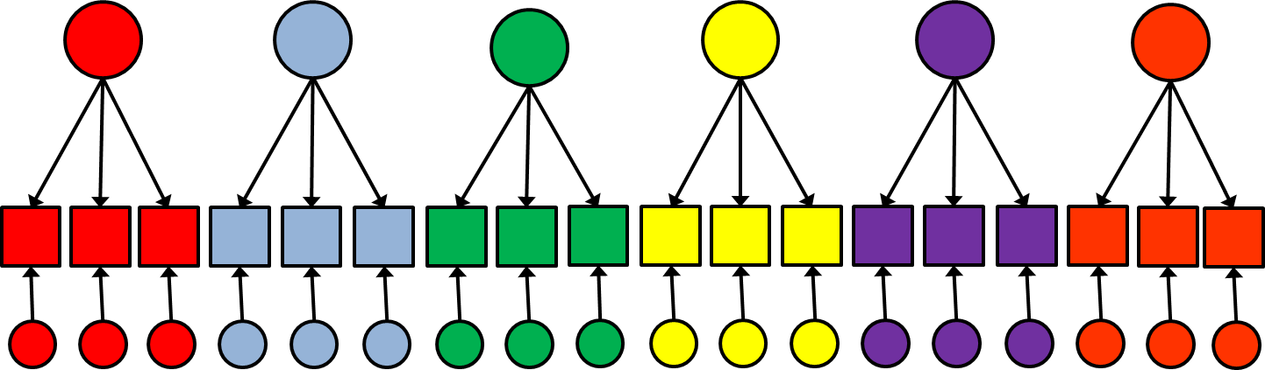
Latent Variable Modeling
Longitudinal modeling

Slide 2
Class of today
Recap of last week
Multigroup models
Measurement invariance
Models for longitudinal data
Autoregression models
Latent curve models

Slide 3
Mean structures
7. We are interested in comparing means when…
We have multiple groups
We have multiple measurement occassions

Slide 4
Multi-group model
Boys
Girls
ζ_{PA}
ζ_{PA}
ζ_{PO}
ζ_{CA}
ζ_{PO}
ζ_{CA}
Parent
Anxiety
Parent
Anxiety
Parental
Over-control
Child
Anxiety
Parental
Over-control
Child
Anxiety
Parent
Perfect-
ionism
Parent
Perfect-
ionism
ζ_{PP}
ζ_{PP}

Slide 5
Multi-group model
Boys
Girls
X
X
Y₁
Y₂
Y₃
Y₄
Y₁
Y₂
Y₃
Y₄
ε_{Y1}
ε_{Y2}
ε_{Y3}
ε_{Y4}
ε_{Y1}
ε_{Y2}
ε_{Y3}
ε_{Y4}

Slide 6
Longitudinal model
Before treatment
After treatment
X
X
Y₁
Y₂
Y₃
Y₄
Y₁
Y₂
Y₃
Y₄
ε_{Y1}
ε_{Y2}
ε_{Y3}
ε_{Y4}
ε_{Y1}
ε_{Y2}
ε_{Y3}
ε_{Y4}

Slide 7
Comparing common factor means
To validly compare common factor variances and means over time we have to establish measurement invariance
Measurement invariance or measurement equivalence indicates that the same construct is being measured across occasions or groups

Slide 8
Comparing common factor means
Testing measurement invariance:
Configural invariance
Weak factorial invariance
Strong factorial invariance
Strict factorial invariance

Slide 9
Configural invariance
Is the underlying construct measured by the same variables?
If not, the common factors don’t represent the same construct across ocassions or groups

Slide 10
Weak factorial invariance
Is the underlying construct measured in the same way by the observed variables?
Before treatment / Girls
Mean
Item 1
After treatment / Boys
Mean common factor

Slide 11
Weak factorial invariance
Is the underlying construct measured in the same way by the observed variables?
If not, differences in observed covariances across occasions or groups do not to the same extent reflect differences in common factor variances

Slide 12
Strong factorial invariance
Are differences in observed variables due to differences in the underlying factor?
Before treatment / Girls
Mean
Item 1
After treatment / Boys
Mean common factor

Slide 13
Strong factorial invariance
Are differences in observed variables due to differences in the underlying factor?
If not, differences in observed means across occasions or groups do not to the same extent reflect differences in common factor means

Slide 14
Strict factorial invariance
Are differences in the variances of observed variables due to differences in the variances of the underlying factor?
If not, then differences in the variances of the observed variables are (partly) due to differences in the variances of the residual factors (e.g., reliability)
But: not required for comparison of means.

Slide 15
Alternative to multigroup models
RFA
MIMIC
What is the difference?

Slide 16
Multigroup model
Boys
Girls
X
X
Y₁
Y₂
Y₃
Y₄
Y₁
Y₂
Y₃
Y₄
ε_{Y1}
ε_{Y2}
ε_{Y3}
ε_{Y4}
ε_{Y1}
ε_{Y2}
ε_{Y3}
ε_{Y4}

Slide 17
RFA
X
Gender
Y₁
Y₂
Y₃
Y₄
ε_{Y1}
ε_{Y2}
ε_{Y3}
ε_{Y4}

Slide 18
RFA
X
Gender
Y₁
Y₂
Y₃
Y₄
ε_{Y1}
ε_{Y2}
ε_{Y3}
ε_{Y4}

Slide 19
MIMIC
X
Gender
Y₁
Y₂
Y₃
Y₄
ε_{Y1}
ε_{Y2}
ε_{Y3}
ε_{Y4}

Slide 20
MIMIC
X
Gender
Y₁
Y₂
Y₃
Y₄
ε_{Y1}
ε_{Y2}
ε_{Y3}
ε_{Y4}

Slide 21

Questions?

Slide 22
Modelling longitudinal data
Autoregression models
Latent (growth) curve models

Slide 23
Autoregression models
The same variable measured several times
Implies that later observations are a direct function of earlier observations, plus time-specific error

Slide 24
Autoregression models
ψ₁₁
ζ₁
YEAR1
x₁
YEAR2
x₂
YEAR3
x₃
YEAR4
x₄
ζ₂
ζ₃
ζ₄
ψ₂₂
ψ₃₃
ψ₄₄

Slide 25
Autoregression models
Can be considered a simple path model
Differences exist in the interpretation of effects and testing of specific hypotheses

Slide 26
Mean structure in pathmodels
Path model
Covariance structure
Σ = (Ι – Β)⁻¹ Ψ (Ι – Β)’ ⁻¹
Mean structure
μ = (Ι – Β)⁻¹ α

Slide 27
Path model means
ζ_{PA}
ζ_{PO}
ζ_{CA}
Parent
Anxiety
Parental
Over-control
Child
Anxiety
Σ = (Ι – Β)⁻¹ Ψ (Ι – Β)’ ⁻¹
Β = Ψ =
Parent
Perfect-
ionism
ζ_{PP}
Notes:
You have learned that this matrix expression consists of a matrix beta that contains the regression coefficients between the variables, or the direct effects between the variables, and the psi matrix that contains the variances and covariances of the residual factors of endogenous and exogenous variables. For exogenous variables the residual variances are equal to the variances of the variables, but for endogenous variables they are the part of the variance that is unexplained by the model.

Slide 28
Path model means
ζ_{PA}
ζ_{PO}
ζ_{CA}
Parent
Anxiety
Parental
Over-control
Child
Anxiety
μ = (Ι – Β)⁻¹ α
μ =
α =
Parent
Perfect-
ionism
ζ_{PP}

Slide 29
Path model means
ζ_{PA}
ζ_{PO}
ζ_{CA}
Parent
Anxiety
Parental
Over-control
Child
Anxiety
μ = (Ι – Β)⁻¹ α
μ =
α = identification?
Parent
Perfect-
ionism
ζ_{PP}

Slide 30
Path model means
ζ_{PA}
ζ_{PO}
ζ_{CA}
Parent
Anxiety
Parental
Over-control
Child
Anxiety
μ = (Ι – Β)⁻¹ α
μ =
α =
Parent
Perfect-
ionism
Number of observed information
ζ_{PP}
4
Saturated mean structure
Number of Parameters
4

Slide 31
Path model means
μ = (Ι – Β)⁻¹ α
μ = means of the observed variables
α = intercept

Slide 32
Path model
ζ_{PA}
ζ_{PO}
ζ_{CA}
Parent
Anxiety
Parental
Over-control
Child
Anxiety
μ = (Ι – Β)⁻¹ α
μ =
To what extent are the means of the variables affected by the means of the other variables?
Parent
Perfect-
ionism
ζ_{PP}

Slide 33
Path model
ζ_{PA}
ζ_{PO}
ζ_{CA}
Parent
Anxiety
Parental
Over-control
Child
Anxiety
μ =
The intercept of an exogenous variable is…??
The intercept of an endogenous variable is…??
Parent
Perfect-
ionism
ζ_{PP}
Notes:
You have learned that this matrix expression consists of a matrix beta that contains the regression coefficients between the variables, or the direct effects between the variables, and the psi matrix that contains the variances and covariances of the residual factors of endogenous and exogenous variables. For exogenous variables the residual variances are equal to the variances of the variables, but for endogenous variables they are the part of the variance that is unexplained by the model.

Slide 34
Autoregression (panel) models
R example…

Slide 35
Autoregression (panel) models
Second order effects
ψ₁₁
ζ₁
YEAR1
x₁
YEAR2
x₂
YEAR3
x₃
YEAR4
x₄
ζ₂
ζ₃
ζ₄
ψ₂₂
ψ₃₃
ψ₄₄

Slide 36
Autoregression (panel) models
R example…

Slide 37
Autoregression (panel) models
Equality of direct effects
ψ₁₁
ζ₁
YEAR1
x₁
YEAR2
x₂
YEAR3
x₃
YEAR4
x₄
ζ₂
ζ₃
ζ₄
ψ₂₂
ψ₃₃
ψ₄₄

Slide 38
Autoregression (panel) models
R example…

Slide 39
Autoregression (panel) models
Equal means?
ψ₁₁
ζ₁
YEAR1
x₁
YEAR2
x₂
YEAR3
x₃
YEAR4
x₄
ζ₂
ζ₃
ζ₄
ψ₂₂
ψ₃₃
ψ₄₄

Slide 40
Autoregression (panel) models
R example…

Slide 41
Autoregression (panel) models with predictors
ψ₅₅
ψ₆₅
ψ₆₆
ζ₅
ζ₆
Gender
x₅
Family status
x₆
YEAR1
x₁
YEAR2
x₂
YEAR3
x₃
YEAR4
x₄
ζ₂
ζ₃
ζ₄
ζ₁
ψ₁₁
ψ₂₂
ψ₃₃
ψ₄₄

Slide 42
Autoregression (panel) models with predictors
R example…

Slide 43
Autoregression (panel) models
Implies that later observations are a direct function of earlier observations, plus time-specific error
Interesting to test:
Whether first-order effects are sufficient to explain the longitudinal relations, or that second-order (or third-order) effects are needed
Equality of autoregressive effects
Whether predictors are able to explain first (and subsequent) measurement occasions

Slide 44
Cross-lagged panel models
ζ₂
ζ₃
ζ₄
ζ₁
YEAR1
x₁
YEAR2
x₂
YEAR3
x₃
YEAR4
x₄
ζ₁
YEAR1
x₁
YEAR2
x₂
YEAR3
x₃
YEAR4
x₄
ζ₂
ζ₃
ζ₄

Slide 45
Cross-lagged panel models
ζ₂
ζ₃
ζ₄
ζ₁
YEAR1
x₁
YEAR2
x₂
YEAR3
x₃
YEAR4
x₄
ζ₁
YEAR1
x₁
YEAR2
x₂
YEAR3
x₃
YEAR4
x₄
ζ₂
ζ₃
ζ₄

Slide 46
Cross-lagged panel models
ζ₂
ζ₃
ζ₄
ζ₁
YEAR1
x₁
YEAR2
x₂
YEAR3
x₃
YEAR4
x₄
ζ₁
YEAR1
x₁
YEAR2
x₂
YEAR3
x₃
YEAR4
x₄
ζ₂
ζ₃
ζ₄

Slide 47
Cross-lagged panel models
ζ₂
ζ₃
ζ₄
ζ₁
YEAR1
x₁
YEAR2
x₂
YEAR3
x₃
YEAR4
x₄
ζ₁
YEAR1
x₁
YEAR2
x₂
YEAR3
x₃
YEAR4
x₄
ζ₂
ζ₃
ζ₄

Slide 48

Questions?

Slide 49
Latent (growth) curve models
The same variable measured several times
Implies that repeated measures are a function of an unobserved random growth process that gave rise to time-specific observed measures
Allows for investigation of between-subject differences in within-subject change

Slide 50
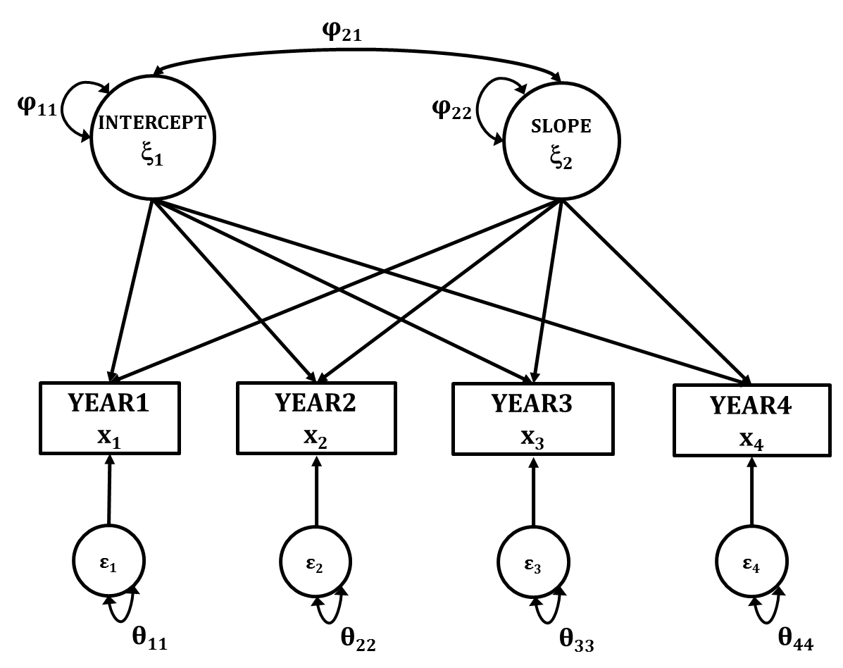
Latent (growth) curve models

Slide 51
Latent (growth) curve models
Can be considered a simple factor model
Differences exist in the specification and interpretation of the latent factors, and testing specific hypotheses

Slide 52
Latent intercept and slope factors

Slide 53
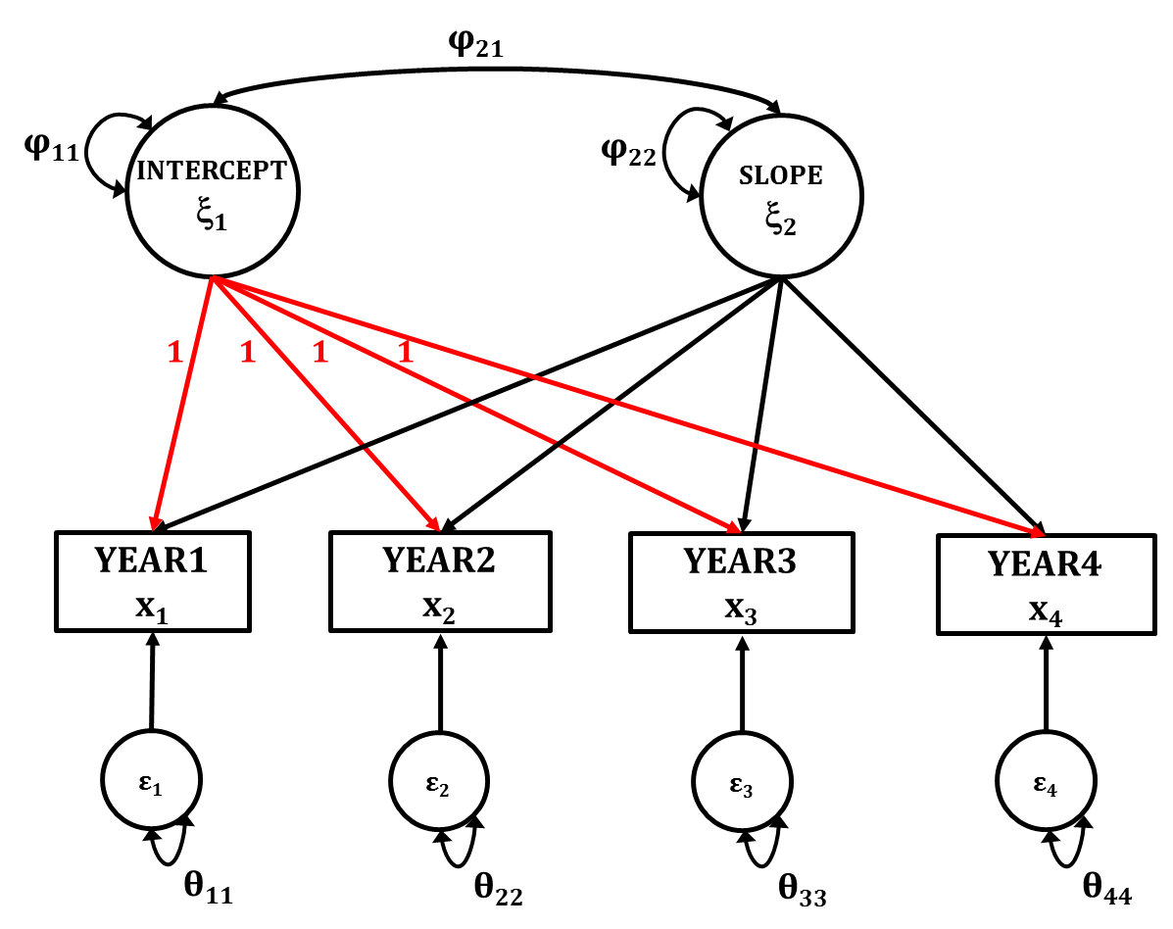
Latent intercept factor

Slide 54
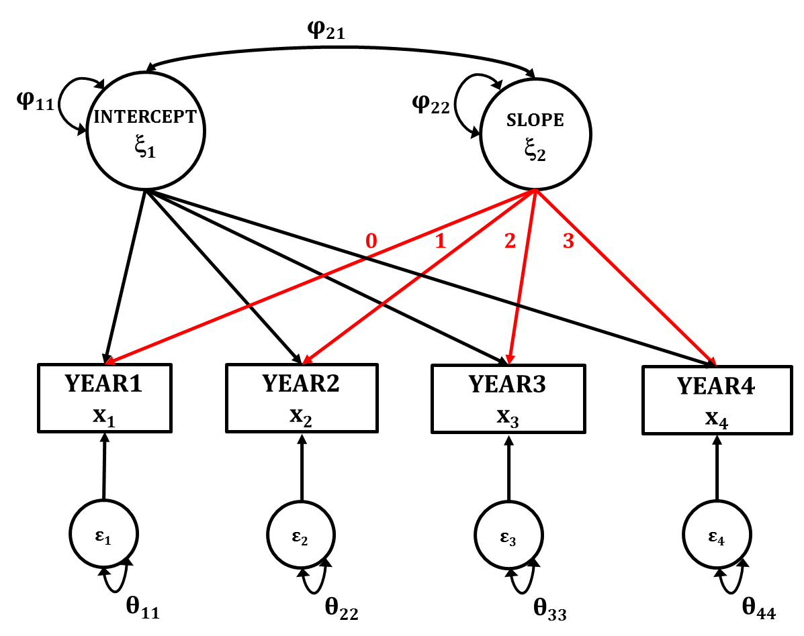
Linear latent (growth) curve factor

Slide 55

Linear latent (growth) curve model

Slide 56
Linear latent curve model
R example…

Slide 57
Latent curve models
Intercept factor
Mean = mean at the first measurement occasion
Variance = variability between subjects in their scores at the first measurement occasion
Curve factor
Mean = mean change over time
Variance = variability between subjects in their change across time

Slide 58
Linear latent (growth) curve model

Slide 59
Latent curve models

Slide 60
Latent curve models

Slide 61
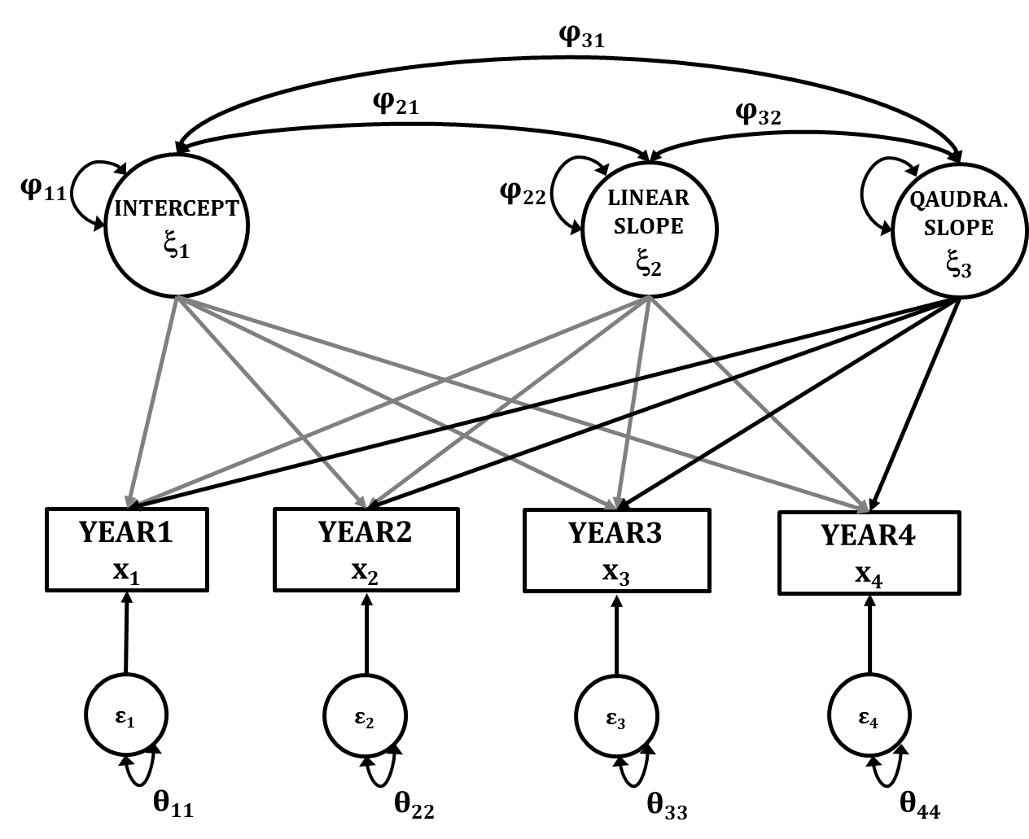
Additional curve factor

Slide 62

Additional curve factor

Slide 63
Quadratic latent curve model
R example…

Slide 64
Latent curve models
Flexibility in defining curves
Linear most used
But non-linear also possible

Slide 65
Latent curve models with predictors
Predicting the means and variances of the intercept and slope factors

Slide 66
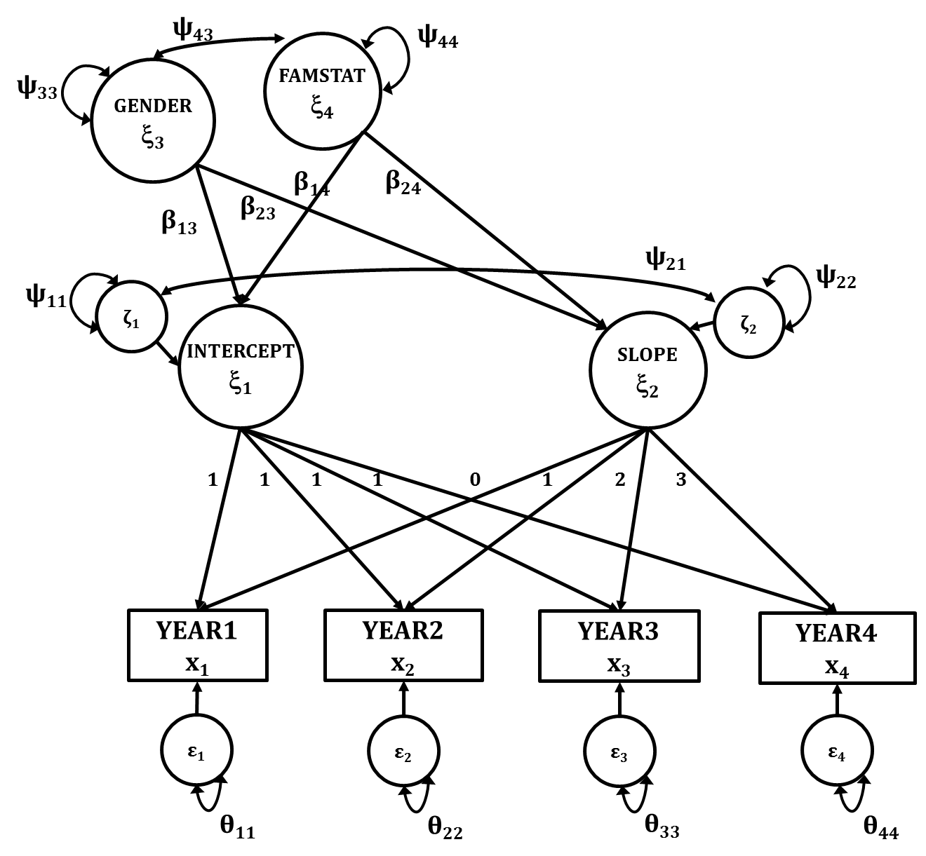
Latent curve models with predictors

Slide 67
Latent curve models with predictors
R example…

Slide 68

Questions?

Slide 69
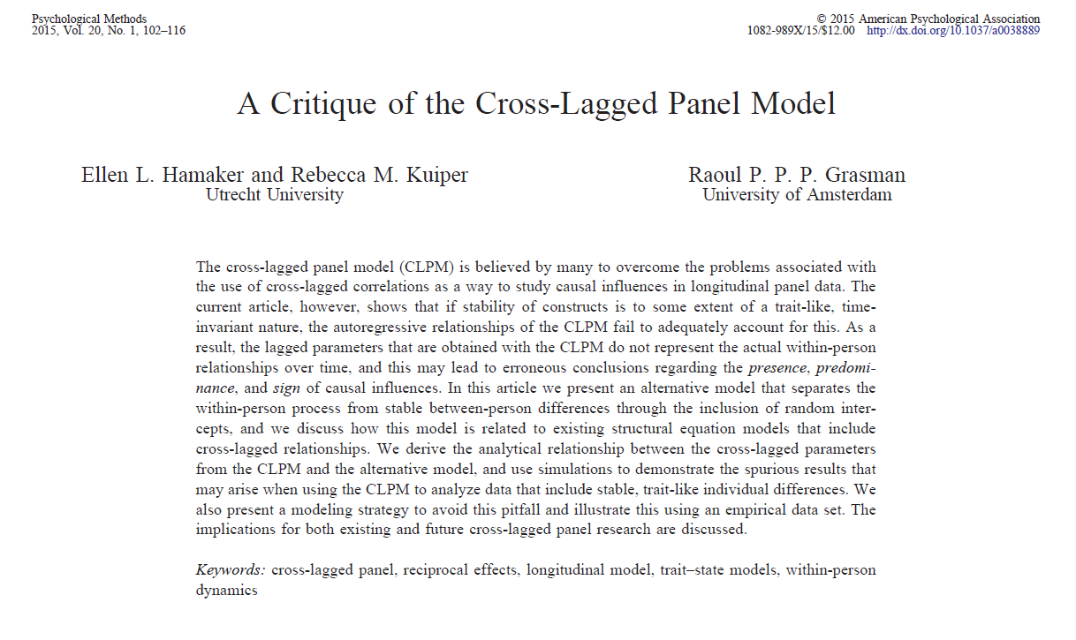
Random intercept cross-lagged panel model
What about including a random intercept in the (cross-lagged) panel model?

Slide 70
ζ₂
ζ₃
ζ₄
ζ₁
YEAR1
x₁
YEAR2
x₂
YEAR3
x₃
ζ₁
YEAR4
x₄
Random
Intercept

Slide 71
Random
Intercept
ζ₂
ζ₃
ζ₄
ζ₁
YEAR1
x₁
YEAR2
x₂
YEAR3
x₃
ζ₁
YEAR4
x₄
ζ₁
YEAR1
x₁
YEAR2
x₂
YEAR3
x₃
YEAR4
x₄
ζ₂
ζ₃
ζ₄
Random
Intercept

Slide 72


Slide 73
Latent intercept autoregression (panel) model
R example…

Slide 74


Slide 75
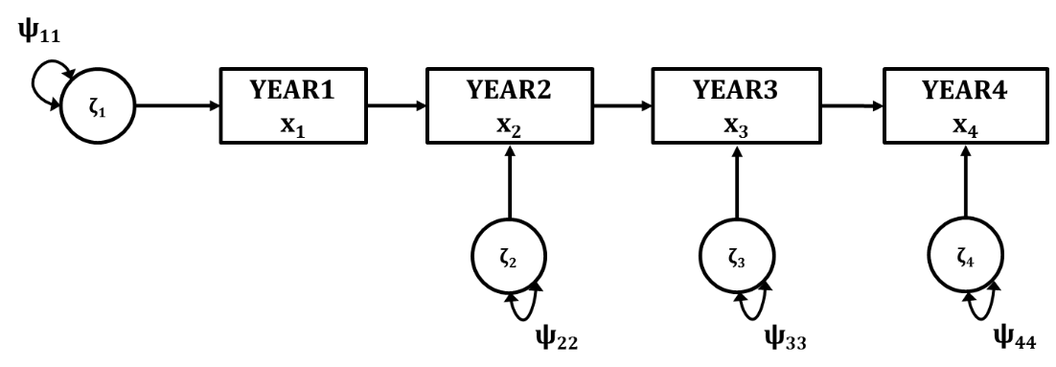
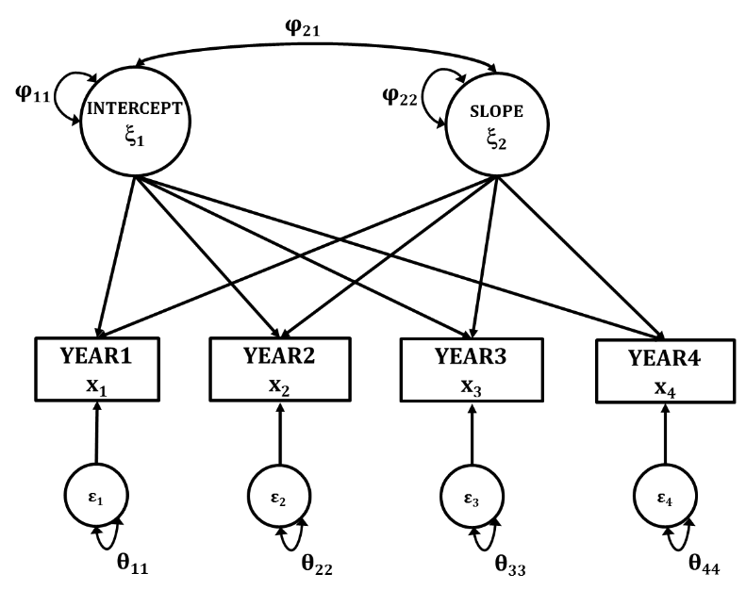
Modelling longitudinal data
Autoregression models
Latent (growth) curve models

Slide 76
Autoregression models
ψ₁₁
ζ₁
YEAR1
x₁
YEAR2
x₂
YEAR3
x₃
YEAR4
x₄
ζ₂
ζ₃
ζ₄
ψ₂₂
ψ₃₃
ψ₄₄

Slide 77
Latent autoregression models
ψ₁₁
YEAR1
x₁
YEAR2
x₂
YEAR3
x₃
YEAR4
x₄
ζ₁
ζ₂
ζ₃
ζ₄
ψ₂₂
ψ₃₃
ψ₄₄

Slide 78
φ₂₁
φ₁₁
INTERCEPT
ξ₁
φ₂₂
SLOPE
ξ₂
YEAR1
x₁
YEAR2
x₂
YEAR3
x₃
YEAR4
x₄
ε₁
ε₂
ε₃
ε₄
θ₁₁
θ₂₂
θ₃₃
θ₄₄

Slide 79
φ₂₁
φ₁₁
INTERCEPT
ξ₁
φ₂₂
SLOPE
ξ₂
YEAR1
x₁
YEAR2
x₂
YEAR3
x₃
YEAR4
x₄
ε₁
ε₂
ε₃
ε₄
θ₁₁
θ₂₂
θ₃₃
θ₄₄

Slide 80


